Slide 1
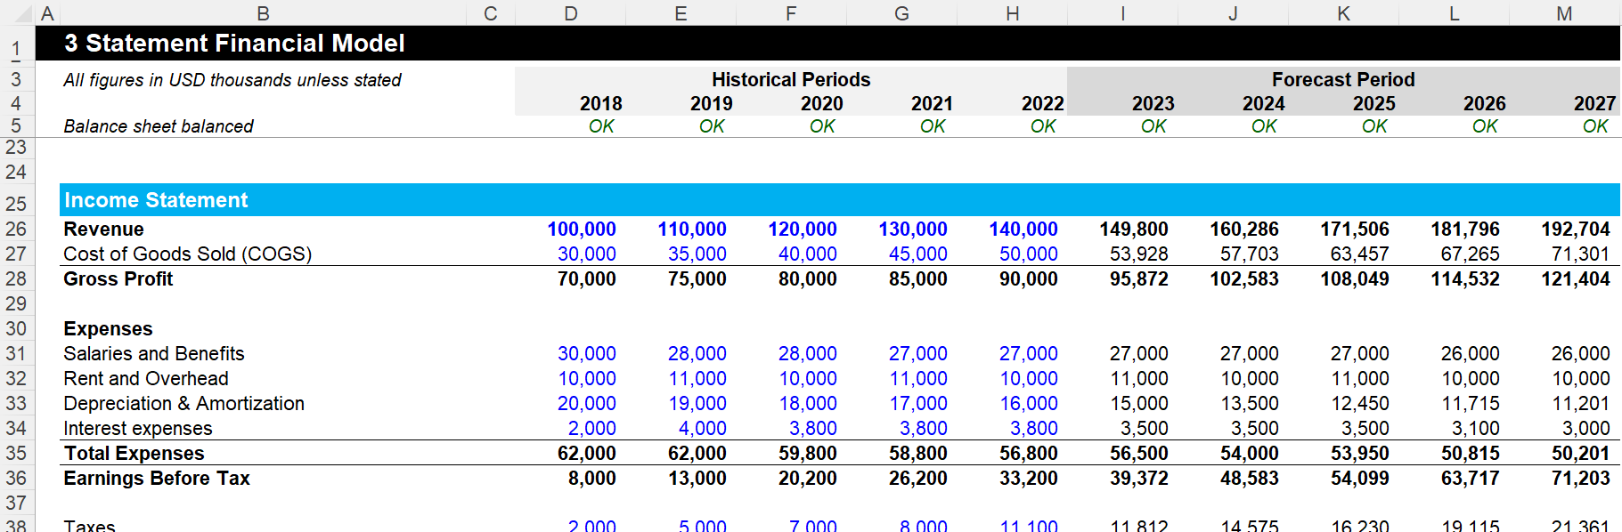
Three Financial Statements Model Example 1 - Tutorial
Confidential
Created by former JP Morgan Investment Bankers, and McKinsey & Deloitte Consultants

Slide 2
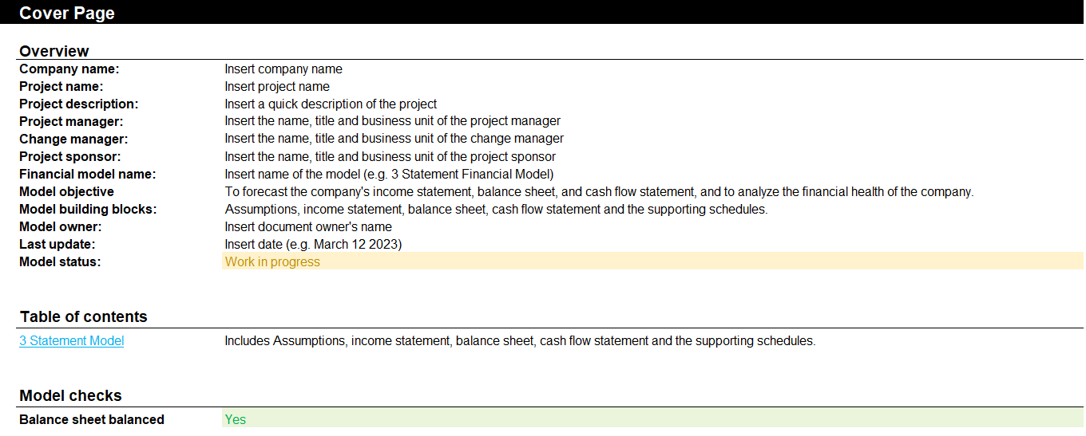
Step 1 - Open the document “Three Financial Statement Model” and fill in the cover page

Slide 3
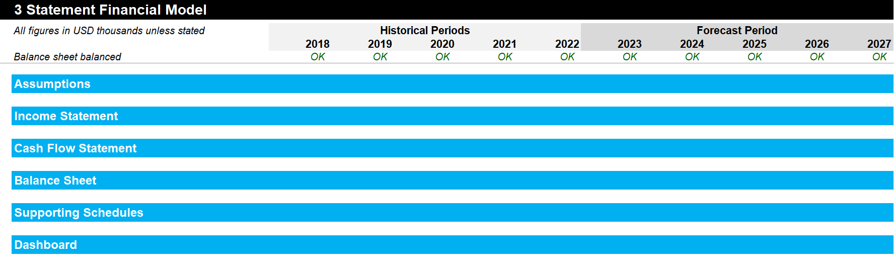
Step 2 - Click on the tab 2 “Three Statement Model” and make sure that you do not need to add or remove a building block based on your specificities
This is a standard Three Statement Model. However, the specificities of your situation may require to add or remove a building block

Slide 4
Step 3 - Adjust if required the periodicity based on the specificities of your organization

Slide 5
Step 4 - Adjust if required the items in each building block
For example, you may decide to add the item “Dividend payout” by adding a row. Or you may decide to remove the interest expenses. If required, you may have to add a row in the assumption building block if it helps you forecast the future dividend payout

Slide 6
Step 5 - Fill in the templates more or less in the order displayed below
Historical Periods
Forecast Period
Assumption
2. Mainly formula and links
3. Mainly input
Income statement
1. Mainly input
4. Mainly formula and links
Balance sheet
Cash flow statement
Working capital
Depreciations
Debt & Interest
Dashboard
5. Mainly links/output

Slide 7
Step 6 - Double check that your balance sheet is balanced
Asset
Liabilities + Shareholders’ Equity
Current asset
Current liabilities
Where the money is going to
Fixed Assets
Where the money is coming from
Long-term Liabilities
Intangible Assets
Shareholder’s Equity & Retained Earnings

Slide 8
Step 7 - If the balance sheet is not balanced, review all your inputs, formulas and links Example of how the income statement and cash flow statement can be linked
From Income statement…
…to Cash flow statement
Revenue
Net income adjusted
Cost of goods sold
Depreciation and amortization
Gross profit
Deferred income taxes
Operating expenses
Changes in accounts receivable
Operating activities
EBITDA
Changes in inventory
Depreciation and amortization
Changes in accounts payable
EBIT
Changes in accrued liabilities
Interest
CAPEX
Investing activities
Income tax expense
Other investing activities
Net Income (Adjusted)
Debt
Net Income
Dividends paid
Financing activities
Dividend payout
Equity Issuances (buybacks)
Net income after distribution
Total change in cash

Slide 9
Step 7 - If the balance sheet is not balanced, review all your inputs, formulas and links Example of how the cash flow statement can be linked directly to the balance sheet
From Cash flow statement…
…to Balance Sheet
Net income adjusted
Cash
Depreciation and amortization
Receivables, net
Deferred income taxes
Inventories
Asset
Operating activities
Changes in accounts receivable
Property, plant and equipment, net
Changes in inventory
Other long-term assets
Changes in accounts payable
Accounts payable
Changes in accrued liabilities
Accrued liabilities
CAPEX
Liabilities
Investing activities
Debt
Other investing activities
Debt
Deferred income taxes
Dividends paid
Equity
Financing activities
Equity
Equity Issuances (buybacks)
Retained earnings
Total change in cash

Slide 10

Interested in more than 1 Toolkit? Access all our Toolkits for half the price with our Gold Access
Gold Access
Click here to learn more

Slide 11

Thanks for your attention!
www.domontconsulting.com

